Slide 1
Mississippi’s Annual Affordable Housing Conference 2022
CHEERS TO 30 YEARS!
Beau Rivage Resort & Casino
Biloxi, MS
March 29 - 31

Slide 2
Programs for Homebuyers

Slide 3
WHO IS ELIGIBLE?
First-time homebuyers or persons who have not owned a principal interest in a residence in the past 3 years, unless purchasing in a Target County or Borrower is a qualified Veteran (active or honorably discharged).
Households that meet the income guidelines based on county & # of persons within the household. Current household income ranges are between $60,000-$103,460 and are subject to change, typically on an annual basis.
Needs down payment and/or closing cost assistance.

Slide 4
WHO IS ELIGIBLE?
Home buyers who meet the conforming credit requirements established by FHA, VA, RD Guaranteed Program, Fannie Mae or Freddie Mac, including those agencies HFA products & any applicable MRB Servicer overlay requirements. If doing a Fannie or Freddie Mac loan, the credit qualifying borrowers must be at or below 80% of the AMI set by FHFA, regardless of those agency’s programs. No exceptions.
Must be or intend to become a resident of MS and U. S. citizen or an Alien admitted for permanent residency.
Credit score depends on the conforming loan product type regulations & any potential Servicer overlays. Example: Standard Mortgage Corporation (SMC) has a minimum FICO score of 640 and they require a minimum of 3 scores. SMC also has a maximum 50% DTI.

Slide 5
$7,000 – 0% 10-Year Deferred Second Mortgage Assistance
Lender prepares 1st & 2nd mortgage LE/CD in their name and funds both loans at the closing table.
Lender completes & provides to the closing agent the following MRB Forms:
- MHC 2nd Mortgage Note & Deed of Trust, generated either through MHC’s system or an alternate document provider,
- Applicable Tax-Exempt Financing Rider*, and
- MRB Borrower Affidavit.
* The Tax-Exempt Financing Rider must be recorded with the Lenders 1st Mortgage Deed of Trust that will be sent to the bond Servicer once recorded.

Slide 6
$7,000 – 0% 10-Year Deferred Second Mortgage Assistance
Lender funds the 1st & 2nd mortgage at the closing table.
MHC is shown as Lender on the Original 2nd Mortgage Note & Recorded Deed Of Trust. Lender is required to mail or overnight MHC’s Original executed Note and Recorded Deed of Trust & Wiring Instructions to MHC within 30-calendar days of closing.

Slide 7
$7,000 – 0% 10-Year Deferred Second Mortgage Assistance
MHC is shown as Lender on the Original 2nd Mortgage Note & Recorded Deed Of Trust & the Originating Lender is shown as the Priority Lender on the 2nd Mortgage Deed of Trust along with their 1st mortgage loan amount. Lender is required to mail or overnight the 2nd Mortgage Original executed Note and Recorded Deed of Trust to MHC – Attn: Single Family.
MHC’s EIN # - 64-0644578

Slide 8
$7,000 – 0% 10-Year Deferred Second Mortgage Assistance
The Purchase Certification (PC) package documents are uploaded to MHC’s Online Reservation System (see checklist), excluding the Original 2nd Mortgage note.
MHC will reimburse the lender with a copy of the recorded 2nd mortgage DOT if all other documents have been received.
Note: Servicer will not purchase the 1st mortgage loan without MHC’s Purchase Certification which is printed from the online system after the status is updated to a Purchase Certification status.
If the borrower meets the 10-year requirement without an event of default, MHC will then satisfy the 2nd Mortgage lien.

Slide 9
BENEFITS TO BORROWER
$7,000 - 0% Deferred 10-year Second Mortgage is forgivable if the 10-year requirement is met without an event of default.
Note: Being that the 1st mortgage is financed with Tax-Exempt Bonds the 2nd mortgage 10-year default period is separate and apart from the IRS Potential Recapture Tax 10-year rule. The use of the bond proceeds that ultimately are used in the financing of the 1st mortgage loan amount when being placed into a Mortgage Backed Security is also applicable if the home is sold or non-owner occupied within the first 10-years.
30- year fixed rate first mortgage. Rates are set by MHC ea. Monday at 9 a.m.

Slide 10
BENEFITS TO BORROWER
Competitive 1st Mortgage interest rates that potentially are adjusted each Monday at 9 a.m.
No liquid asset limit is applicable.
No reservation fee is required for reservation.
If using the Fannie Mae HFA Preferred product or the Freddie Mac HFA Advantage product, the credit qualifying borrowers household income must be at or below 80% of the AMI set by FHFA. The borrower would receive an 18% MI but could be lower depending upon the LTV.

Slide 11
MRB GUIDELINES
Cost of the home must be within the maximum permissible acquisition limit based on the county in which the property is located:
Acquisition limit for Target area: $309,000
Acquisition limit for Non-target area: $258,000
First time homebuyer requirement (3 yr. rule) unless purchasing in a Target area county or census tract. See “MRB7 Lender Resources” link for chart
Household income limits
Pre-Purchase Home Homebuyer Education is Required upfront (Online education is permitted).
No discount points are allowed to be charged to either the buyer or seller.

Slide 12
MRB GUIDELINES
MRB Checklist must be followed when uploading documents for the Reservation and Compliance Packages for MHC compliance review.
Reservation Package
Due within ten (10) calendar days from date of Reservation.
Compliance (MHC Approval Package)
Due within 45- days on Existing/New or 120- days for Proposed Construction loans.

Slide 13
MRB GUIDELINES
Compliance (MHC Approval Package, cont’d)
- Credit report and Fraud Guard or equivalent report, will be reviewed by MHC & the Lender to determine if the IRS homebuyer compliance guidelines are met regarding no homeownership interest in the prior 3 years. The new Borrower Certification does allow MHC to ask for 3-years tax returns on ALL household occupants in the event MHC isn’t satisfied with what is found on the Credit report &/or Fraud Guard reports.
Purchase Certification Package (PC – MHC’s Closing Pkg. - This is not the complete list of documents required for PC approval):
Uploaded Borrower Affidavit
Uploaded copy of 1st & 2nd Mortgage Closing Disclosures
Uploaded copy of recorded 2nd Mortgage Deed of Trust (Maturity date is 10-years from the date of loan closing.
Upload Lender Wiring Instructions

Slide 14
MRB PROGRAM ASSISTANCE FEATURES
$7,000 – 0% deferred 10-year second mortgage can be applied to the borrower’s 1st mortgage portion of allowable closing costs and down payment as follows:
Origination Fee (Up to 1.5%, optional fee)
Attorney Fees
Title Fees (includes Title Policy) ) – MHC should be reflected as Second Mortgagee.
Survey
Inspection Fees
Recording Fees (Can be charged 2nd mortgage)
Appraisal Fee, if not POC

Slide 15
MRB PROGRAM ASSISTANCE FEATURES
Credit Report (If not a POC item)
Down Payment (Can be more than minimum required)
Flood Certification
Amortization Fee
Upfront MIP, PMI, VA Funding & RD Guarantee Fee
Application Fee (Can be charged on the 2nd Mortgage, if applicable)
Home buyer Education fee, (Can be charged on 2nd Mortgage, if applicable)
Any other allowable Borrower costs
Notes: - Borrower can receive Earnest Money back at closing but no MHC funds…
- If funds remain from the 2nd mortgage, they’re to be applied as a Principal Reduction after the loan closes. Unless noted above, no other fees can be charged to the buyer on the 2nd Mortgage CD

Slide 16
MRB PROGRAM ASSISTANCE FEATURES
Property must be owner-occupied as the principal residence (NO Investment Properties allowed)
Single family detached
Fee simple townhomes
Condominiums that meet conforming loan product guidelines
Permanently affixed manufactured homes that meet FHA, VA, RD, or Fannie Mae requirements
Note: Freddie Mac Manufactured Housing is not allowed at this time under the HFA Advantage product.

Slide 17
MRB PROGRAM ASSISTANCE FEATURES
Manufactured Housing is allowed for Fannie Mae HFA preferred product depending upon any Servicer overlay.
Below is an excerpt from the U/W section on the Fannie Mae Loan –
Per Selling Guide, except as modified by this variance.
Lender must choose the HFA Preferred option on the Community Lending screen in DU.
Mortgages secured by manufactured homes must be underwritten by DU as required by the Selling Guide; however, Lender may disregard any DU message that the loan casefile is ineligible because the CLTV exceeds 95%.

Slide 18
MRB RATE LOCK FEATURES
Rates are subject to change each Monday at 9 a.m. See our Homepage at www.mshomecorp.com –
Daily MRB7 rates are available for:
45-day locks on existing/new (less than 12 mos. never occupied) or
120-day locks on proposed construction
30-day extensions are available for a cost of $50 (paid on MHC website under found “Lenders/Realtors” link).

Slide 19
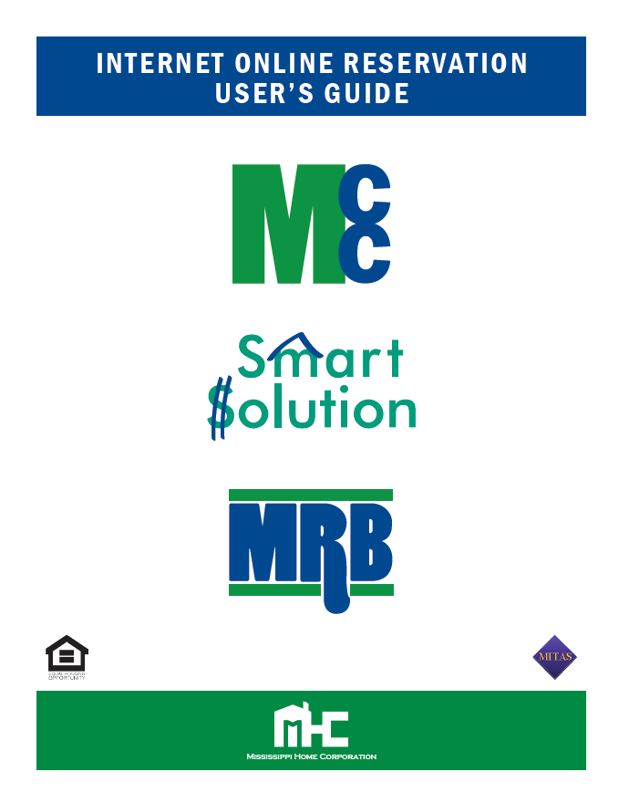
MRB RESERVATION SYSTEM
All reservations must be made through MHC’s Online Reservation Site. Lender login is found under the “Lenders/Realtors” link or any Program Lender Resources links -
An Internet Online Reservation User’s Guide
Is also fund under the “Lenders/Realtors” link
on MHC’s Homepage.
Note: Lender can view their pipeline,
outstanding conditions & delinquent Documents.

Slide 20
MRB RESERVATION AND PROCESSING RECAP
Lender reserves only the 1st mortgage loan on MHC’s system and then have 10-calendar days to upload the Reservation Pkg. documents to MHC or the loan can be canceled.
Lender processes 1003, 1st & 2ND Mortgage LE/CD in lenders name.
Lender reserves the loan through MHC’s online reservation system after receiving the Lenders underwriting approval.
After locking the bond loan with MHC, the loan must then be locked with the bond Servicer.
MHC is to be placed as Secondary Mortgagee on the HO Ins. Policy using the following information:
Mississippi Home Corporation, 735 Riverside Drive, Jackson, MS 39202

Slide 21
MRB RESERVATION AND PROCESSING RECAP
If using the Fannie Mae HFA Preferred product, use Special Feature codes as follows: 118 - Community Second, 782 – State Housing Authority & 127 for HFA Preferred. The Second Mortgage must be coded as a Community Second on the Fannie Mae products. The borrower will receive the 18%
For Fannie Mae or Freddie Mac products, MHC requires that the Lender use FHFA Home Ready or Home Possible 80% or below AMIs for the credit qualifying borrowers (above 80% will not be allowed with MRB loans).
The household MRB Household income limits must still be met and reported when reserving the loan online with MHC.

Slide 22
MRB RESERVATION AND PROCESSING RECAP
If using Freddie Mac’s HFA Advantage product, select HFA Advantage under the Loan Identifier Code (LIC) section. Using HFA Advantage allows the lender to follow only MHC’s MRB Household Income Limits and the borrower will receive the 18% reduced MI.
Lender scans and uploads required file doc.’s per the MRB Checklist.
- Reservation Package
- Compliance Package
- Purchase Certification Package, excluding original Final Documents which are mailed to MHC’s Single- Family Dept.

Slide 23
MRB RESERVATION AND PROCESSING RECAP
After MHC approval an email will be sent to the email attached to the person who reserved the loan to notify them the loan has been approved. The Lender then prints the MRB7 Conditional Commitment found under “Print Documents” link from the Reservation system & then notifies Closing Dept. to print documents required for closing.
Within 30-calendar days from closing the Lender scans & uploads required Purchase Certification (PC) package doc.’s, per MHC’s Checklist (see “Print Documents” within the Reservation system).
Lender will then print the PC after MHC has updated the loan status to Purchase Certification and provide to the MRB Servicer.

Slide 24
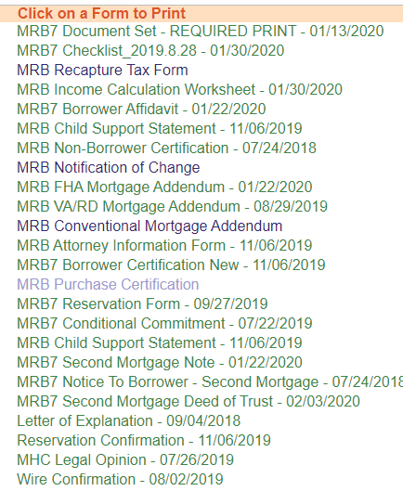
MRB RESERVATION PRINT DOCUMENTS LINK

Slide 25
MRB DOCUMENT UPLOAD PROCESS
The remaining Purchase Certification (PC) pkg. documents must be uploaded to MHC’s Online Reservation System.
If the borrower meets the 10-year requirement without an event of default, MHC will satisfy the 2nd Mortgage.

Slide 27
WHAT IS A MCC?
MCC Tax Credits come from converting MHC’s bond authority to tax credits.
This certificate reduces the amount of Federal Income Tax the borrower must pay which in turn frees up income to qualify.
The federal government allows a home-owner to claim an itemized federal income tax deduction for all the interest paid each year for a mortgage loan.
The MCC allows you to take a tax credit equal to 40% of the annual mortgage interest on a conventional residence or a manufactured home.

Slide 28
WHAT DOES A MCC CUSTOMER LOOK LIKE?
No liquid asset limit is applicable.
Household income range between depending on county -$60,000 – $103,460
Looking for tax savings
Credit ready buyer
Needs more income each month
Reservation fee is $300 or is waived if used with the Smart Solution product.

Slide 29
BENEFITS TO THE BORROWER
Full Loan Amount Financed: $ 130,000.00
Interest Rate: X 4.00%
Annual Mortgage Interest $ 5,260.00
MCC Percentage
X 40%
= $ 2,080.00*
2 Ways to take credit: Annually or Monthly
Monthly Savings = $166.66
You claim 60% of the Mortgage Interest & reduce your tax liability by $2,000 on your federal tax returns.
*Maximum annual tax credit per IRS = $2000. In this example funds remain, and they can be rolled into the next year.

Slide 30
MCC GUIDELINES
Meets household income limit based on county and number of persons in the household.
Cost of the home must be within the maximum permissible acquisition limit based on the county in which the property is located:
Acquisition limit for Target area: $309,000
Acquisition limit for Non-target area: $258,000
Pre-Purchase Homebuyer Education is Required upfront (Online education is permitted).

Slide 31
MCC PROPERTY REQUIREMENTS
Property must be owner-occupied as the principal residence (NO Investment Properties allowed)
Single family detached
Fee simple townhomes
Condominiums that meet conforming loan product guidelines
Permanently affixed manufactured homes that meet FHA, VA, RD, or Fannie Mae requirements
Note: Freddie Mac Manufactured Housing is not yet allowed at this time under the HFA Advantage product.

Slide 32
MCC LOCK FEATURES
Reserve loan at www.mshomecorp.com – Lenders Link
Locks are good for:
45-day locks on existing/new (less than 12 mos. never occupied) or
120-day locks on proposed construction
30-day extensions are available for a cost of $50 (paid online)

Slide 33
MCC RESERVATION AND PROCESSING STEPS
Lender reserves the loan through MHC’s online reservation system after receiving the Lenders underwriting approval.
If using the Fannie Mae HFA Preferred product, use Special Feature codes as follows: 118 - Community Second, 782 – State Housing Authority & 127 - for HFA Preferred. The Second Mortgage must be coded as a Community Second on the Fannie Mae products. The borrower would receive the 18% MI depending on the LTV & MHC requires that the Lender use FHFA Home Ready 80% or below AMIs for the credit qualifying borrowers (above 80% will not be allowed). The household MCC Household income limits must still be met and reported when reserving the loan online with MHC.
If using Freddie Mac’s HFA Advantage product, select HFA Advantage under the Loan Identifier Code (LIC) section. Using HFA Advantage allows the lender to follow only MHC’s MCC Household Income Limits and the borrower will receive the 18% reduced MI. MHC requires that the Lender use FHFA Home Possible 80% or below AMIs for the credit qualifying borrowers (above 80% will not be allowed). The household MCC Household income limits must still be met and reported when reserving the loan online with MHC.

Slide 34
MCC RESERVATION AND PROCESSING STEPS
Lender scans and uploads required file doc.’s per the MCC Checklist.
- Reservation Package
- Compliance Package
- Closed Loan Package. If using the Smart Solution loan, the MCC Closing Package documents are uploaded to the MCC loan, not the Smart Solution loan.
After MHC approval the Lender prints the MCC Conditional Commitment.
Note: Lender can view their pipeline, outstanding conditions & delinquent documents
Lender scans and uploads required the Closing package doc.’s, per MCC Checklist, within 30-business days from closing.

Slide 35
MCC CLOSING PROCESS
Lender scans and uploads required file doc.’s per the MCC Checklist within 30- calendar days from closing.
- Closed Loan Package. If using the Smart Solution loan, the MCC Closing Package documents are uploaded to the MCC loan, not the Smart Solution loan. After MHC approval the Lender prints the MCC Conditional Commitment.
Note: Lender can view their pipeline, outstanding conditions & delinquent documents

Slide 37
Down payment help
SMART SOLUTION SECOND MORTGAGE
4.5% of the Full Loan amount is provided as a down payment 10-year amortizing second mortgage loan.
Second Mortgage rate matches as the first mortgage interest rate (rates subject to change daily).

Slide 38
What does a smart solution customer look like?
640 or above credit score is required for all loan types
Household income up to $95,000 unless using the Freddie Mac HFA Advantage program. If Freddie Mac product is used, the credit qualifying borrowers combined income cannot exceed 80% of AMI set by FHFA.
Needs cash for down payment & closing costs
Looking for a 30-year fixed rate mortgage
Does not have to be a first-time homebuyer

Slide 39
What are the benefits to the borrower?
Cash for down payment &/or closing cost assistance
30-year fixed rate mortgage
Can be Freddie Mac Conventional loan, FHA, Rural Development Guaranteed or VA loan.
Can be combined with Mortgage Credit Certificate (MCC) program for an additional tax benefit.
Competitive rates subject to change daily
18% MI if using the Freddie Mac HFA Advantage product.

Slide 40
Smart solution guidelines
Borrower’s Total Debt-to-Income Ratio may NOT exceed 45%.
Must have at least 2 credit scores and lender will use the lower of the two looking at the highest income borrower. If there are 3 the middle score may be used.
No borrower or spouse on title is allowed to have unpaid, unsatisfied or unreleased federal or state tax liens
MHC pays the lender Service Release Premiums of 2.0% on a Freddie Mac Conventional loan or 2.5% on a Government loan (FHA, VA, RD).

Slide 41
Smart solution guidelines
Purchase loans only. Must serve as the homebuyer’s primary residence (NOT TO BE USED AS INVESTMENT PROPERTY).
Smart Solution loans are provided through MHC Participating Lenders and serviced by ServiSolutions, a Division of Alabama Housing Finance Agency (AHFA).
Pre-Purchase Homebuyer Education is required for at least one Borrower. (Online education courses are permitted.)

Slide 42
Smart solution guidelines
MHC/AHFA will only accept approved, automated underwriting files of FHA, Freddie Mac Conventional, RD, and VA approvals
DU, LPA or FHA Total Scorecard Findings resulting in Approve/Eligible or Accept/Accept or GUS for RD Guaranteed loan product
NO MANUAL UNDERWRITING

Slide 43
Smart solution guidelines
Maximum purchase price limits are based on applicable maximum limits set by FHA, VA, RD and Freddie Mac (Non occupant co-signers aren’t allowed under the HFA Advantage product).
If using the Freddie Mac HFA product, the Investor Feature Identifier (IFA) is HFA Advantage.
Lender must provide the most current year’s IRS tax transcripts or executed 1040 w/schedules, if applicable, for each household member (includes 18 years of age and older, if not a full-time student).

Slide 44
Smart solution guidelines
Lender will close the 1st & 2nd loan in their name & funds loans at closing table. Borrower is instructed that the 1st payment will be made to the lender unless the loan is purchased by ServiSolutions prior to the first payment being made.
The First Mortgage Note is endorsed to ServiSolutions, a Division of Alabama Housing Finance Authority without recourse & the Second Mortgage Note is endorsed to Mississippi Home Corporation without recourse (see AHFA FAQ’s online & can be accessed via MHC’s Smart Solution Lender Recourses page.

Slide 45
Smart solution property guidelines
Property being purchased must be located in the State of Mississippi.
Detached single family homes of no more than one dwelling unit
Attached single family homes of no more than four units
Approved Condominiums
Approved FHA Manufactured Homes that meet conforming guidelines that are permanently affixed (Freddie Mac HFA Advantage is not allowed with manufactured homes).

Slide 46
Smart solution property guidelines
FHA FINANCED MANUFACTURED HOMES MUST:
Be affixed to land
Be classified and taxed as real estate
Have manufactured home title surrendered/canceled with copy of cancelation provided to MHC
Must be insured under Section 203(b) of the National Housing Act of 1934, as amended

Slide 47
Smart solution Freddie mac hfa advantage product

Slide 48
Smart solution online reservations
INTERNET RESERVATION SYSTEM FOR LENDERS
Lenders reserve approved, automated underwriting files with underwriter validated findings.
Lenders scan and upload LPA/DU findings & file documents to MHC’s Online System.
Once MHC approves the loan, the Lender will receive an email notifying the approval then Lender prints the Smart Solution Conditional Commitment.
The Lender can view their pipeline, outstanding conditions & delinquent documents.
Lenders must scan & upload loan purchase packages to MHC and AHFA following the Request for Funding Checklist & mails the Final Loan Documents to ServiSolutions.

Slide 49
Smart solution online reservations
Reservations for mortgage loans will be accepted from all designated lending offices of the Lender, defined as lending institutions that have executed a Smart Solution Origination Agreement with MHC to participate in the Program depending upon the Lender Corporate guidelines.
Prior to making a reservation request, there must be a Sales Contract and the Lender must have the loan approved by your company's delegated underwriter.

Slide 50
Smart solution online reservations
All reservations must be made through MHC’s Online Reservation at:
www.mshomecorp.com and click on the “Lenders/Realtors “ tab to see Login link. Available from 9 a.m. – 11:30 p.m. M-F.
Fax requests for reservations will be accepted only if the website is unavailable for more than 24 hours.

Slide 51
Smart solution
STEPS FOR RESERVATION AND PROCESSING:
Eligible borrower applies for mortgage financing with a Participating Smart Solution Lender.
Lender determines if applicant is eligible for the Smart Solution program-based program guidelines. MHC suggests not reserving the loan until the loan has been underwritten due to 30-day closing requirement.
Mortgage is processed in compliance with program guidelines and FHA, VA, RD, or Freddie Mac (HFA Advantage program).

Slide 52
Smart solution
CONTINUING RESERVATION AND PROCESSING STEPS:
Lender can access the reserved loans 24/7 to upload documents or change loan information as long as MHC hasn’t changed the status to Reservation Package Received.
Once the loan is reserved the lender the system will generate a Reservation Confirmation that needs to be printed. This document is a required to be uploaded to MHC. NOTE: Don’t reserve the loan unless you know the loan will close within 30-days.

Slide 53
Smart solution guidelines
Since loan rates are updated daily, best practice is to always check the rate and notify your borrower before reserving the loan.
The Lender must furnish MHC with the Reservation package, using the Smart Solution Transmittal Checklist, within 3-business days. from reservation or risk cancellation of the Reservation of Funds and Rate Commitment.
Documentation should be uploaded to MHC Online Reservation site
Faxed documentation is NOT acceptable

Slide 54
Smart solution rate locks
Rates will be posted daily on business days on our Homepage at 9 a.m. M-F at www.mshomecorp.com. Daily rates will be available with 30-day locks.
NO COMMITMENT/RESERVATION FEE
30-day extensions are available for a cost of 0.25% of the 1st mortgage total loan amount (Fee is to be paid online).
One 15-day extension can be made at no cost (if add’ l. 15- days needed, the .25% Ext. fee is applicable).
Lender will print & upload the Notification of Change form selecting the 15 or 30-day extension being requested & enter the new closing date.

Slide 55
Smart solution – servisolutions (servicer)
Loans that are not delivered in fundable format within 10-days of the reservation expiration will not be paid per-diem interest from the 10th day until the funding date.
If the loan isn’t sold to ServiSolutions within 60-days of the reservation date, there will be a .25% late delivery fee netted from the purchase proceeds.
If the loan isn’t sold within 100-days of the reservation date, there may be a pricing adjustment fee on top of the late delivery fee netted from the purchase proceeds

Slide 56
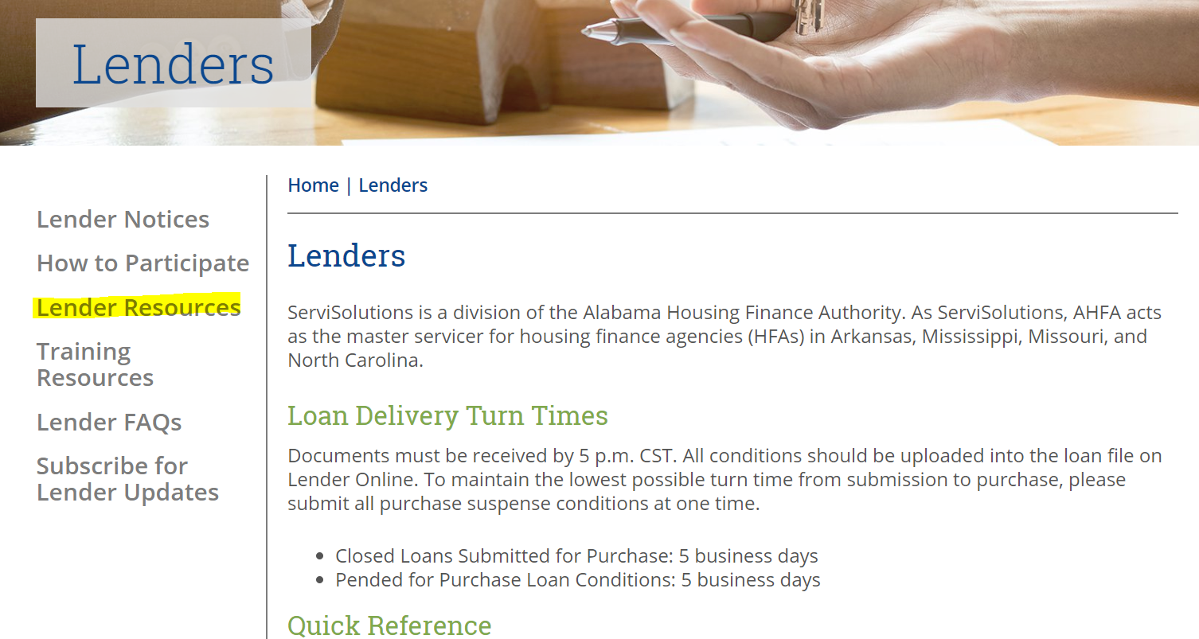
Servisolution lender site

Slide 57
Smart solution
May be used with MHC’s Mortgage Credit Certificate (MCC)!
MCC guidelines (IRS Reg.’s) will always take precedence over the Smart Solution guidelines, i.e., income limit, 1st time homebuyer rule and purchase price limit.

Slide 59
HOUSING ASSISTANCE FOR TEACHERS
In rural Mississippi there exists a critical shortage of qualified teachers. In response to this need, the Mississippi Legislature passed the “Mississippi Critical Teacher Shortage Act of 1998”, which offers attractive incentives for qualified teachers.
The purpose of Housing Assistance for Teachers Program (HAT) is to provide down payment, closing costs, and prepaid costs to licensed teachers up to $6,000 in the form of a grant.
Critical shortage areas in the state are determined by the State Board of Education

Slide 60
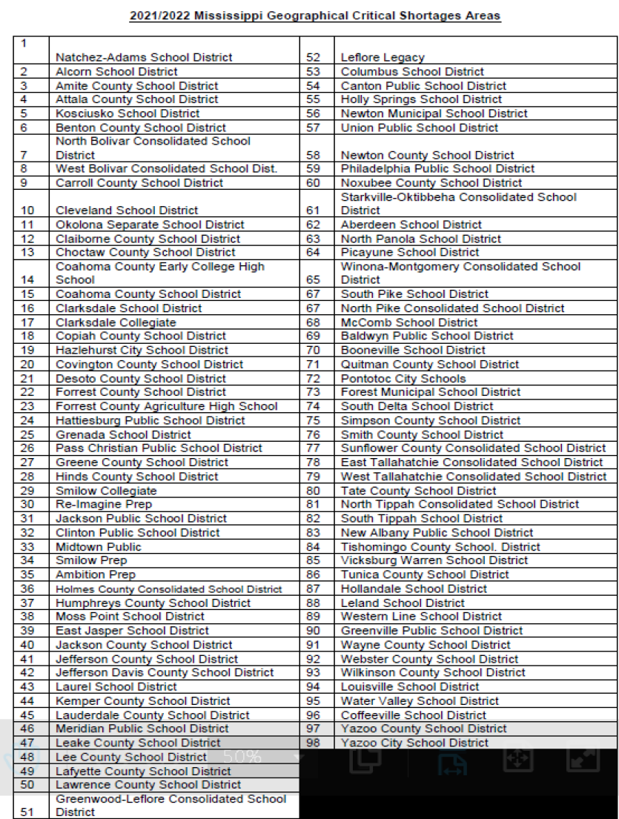
HOUSING ASSISTANCE FOR TEACHERS

Slide 61
HAT REQUIREMETNS AND BENEFITS
Credit ready buyer that needs help with down payment & closing costs
Teacher commits to teach for a period of no less than 3 years in a critical shortage public school district.
Looking for a 20- or 30-year fixed rate mortgage (FHA, VA, RD, Fannie Mae or Freddie Mac loan product).
No Income restriction
Grant will be forgiven if teacher fulfills the 3-year teaching requirement. A third of the grant is forgiven each year & the teacher must submit new contracts to MHC during the 3-year period.

Slide 62
We are here to help!
Macie Carney
AVP of Marketing
macie.carney@mshc.com
601-718-4616
Betty Temple-Putnam
Sr. VP of Single Family
betty.temple@mshc.com
601-718-4664
Matthew Bolton
AVP of Single Family
matthew.bolton@mshc.com
601-718-4686
735 Riverside Dr. | Jackson, MS 39202 | 601-718-4642 | mshomecorp.com

